Slide 1
Image and File Format

Slide 2
Before we begin with what vector graphics and raster graphics are, we must understand a few basic terms:
Pixel : In Computer graphics a pixel, dots, or picture element is a physical point in a picture. A pixel is simply the smallest addressable element of a picture represented on a screen.
A majority of pictures that we see on our computer screen are raster images. The selfie that you click with your mobile phone is another example of a raster image. An image is made up using a collection of pixels referred to as a bitmap.
Bitmap : In computer graphics, a bitmap is a mapping from some domain (for example, a range of integers) to bits, that is, values which are zero or one. It is also called a bit array or bitmap index. The more general term pixmap refers to a map of pixels, where each one may store more than two colors, thus using more than one bit per pixel. Often bitmap is used for this as well. In some contexts, the term bitmap implies one bit per pixel, while pixmap is used for images with multiple bits per pixel.

Slide 3
What is Raster Graphics? In the world of digital photography and computer graphics, a raster is a technique that defines a two-dimensional picture as a grid of square pixels or a rectangular matrix that we are able to view through computer display, paper, and many other mediums.
What is Vector Graphics?
In the world of computer graphics, a vector is the collection of techniques for constructing visual images straight from geometric shapes illustrated on a Cartesian plane, such as lines, curves, points, and polygons.
These are basically known as computer images constructed utilizing a series of commands or mathematical statements that put lines and shapes in a two-dimensional or three-dimensional area or space.

Slide 4
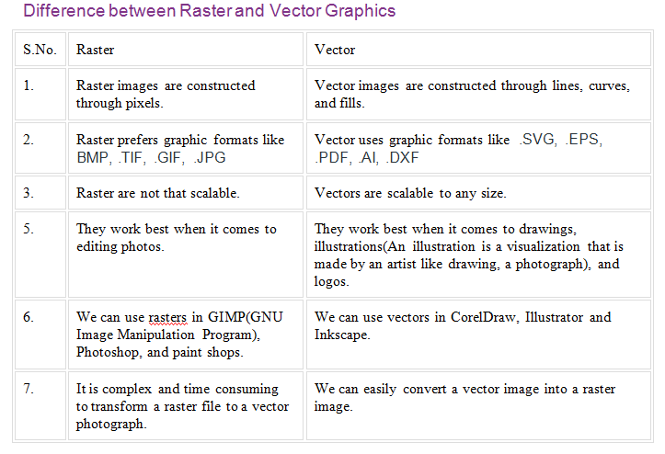

Slide 5
About pixel dimensions and printed image resolution
Pixel dimensions measure the total number of pixels along an image’s width and height. Resolution is the fineness of detail in a bitmap image and is measured in pixels per inch (ppi). The more pixels per inch, the greater the resolution. Generally, an image with a higher resolution produces a better printed image quality

Slide 6
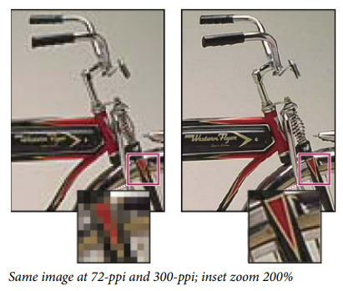
In Photoshop, you can see the relationship between image size and resolution in the Image Size dialog box (choose Image > Image Size)

Slide 7
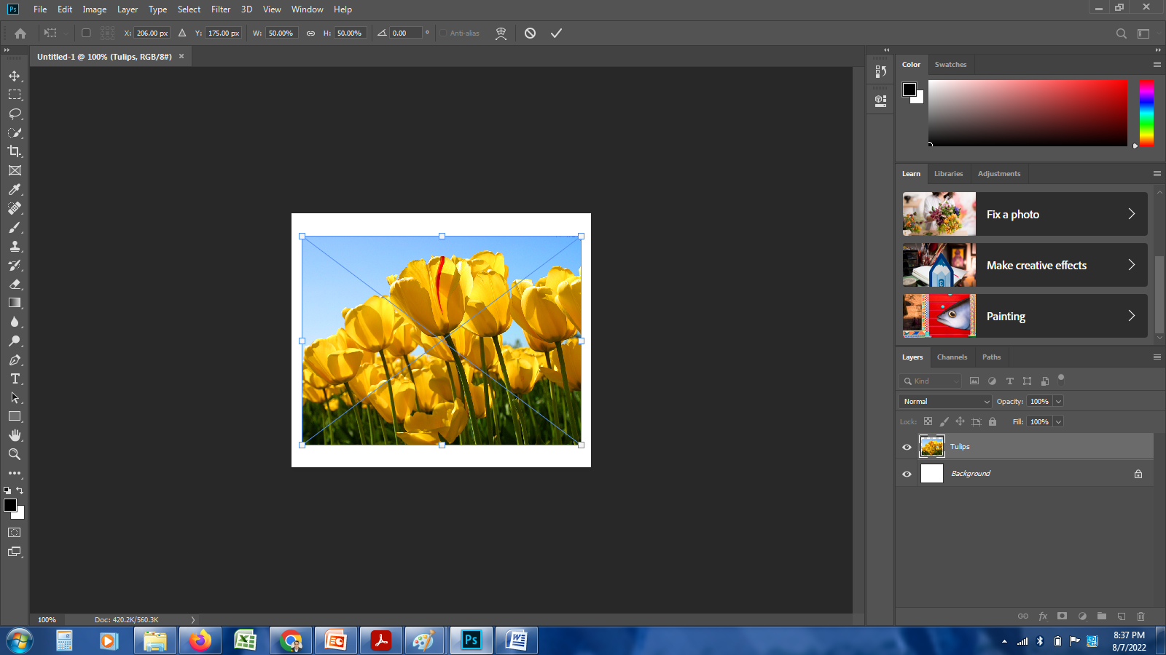

Slide 8
High Resolution vs. Low Resolution
Have you heard your designer talk about DPI or PPI? DPI stands for "dots per inch" and PPI translates to "pixels per inch." These units of measure are essential for determining if the density of pixels in an image is appropriate for the application you are using.
The biggest thing to note when determining what DPI or PPI you require is if you are using an image for print or web. Websites display images at 72dpi, which is low resolution; however images at this resolution look really crisp on the web.

Slide 9
File formats
JPEG (or JPG) - Joint Photographic Experts Group
PNG - Portable Network Graphics
GIF - Graphics Interchange Format
TIFF - Tagged Image File
PSD - Photoshop Document
PDF - Portable Document Format
EPS - Encapsulated Postscript
AI - Adobe Illustrator Document
RAW - Raw Image Formats

Slide 10
1. JPEG (or JPG) - Joint Photographic Experts Group
JPEGs might be the most common file type you run across on the web, and more than likely the kind of image that is in your company's MS Word version of its letterhead. JPEGs are known for their "lossy" compression, meaning that the quality of the image decreases as the file size decreases.
You can use JPEGs for projects on the web, in Microsoft Office documents, or for projects that require printing at a high resolution. Paying attention to the resolution and file size with JPEGs is essential in order to produce a nice-looking project.

Slide 11
2. PNG - Portable Network Graphics
PNGs are amazing for interactive documents such as web pages. While PNGs are "lossless," meaning you can edit them and not lose quality, they are still low resolution.
The reason PNGs are used in most web projects is that you can save your image with more colors on a transparent background. This makes for a much sharper, web-quality image.

Slide 12
3. GIF - Graphics Interchange Format
GIFs are most common in their animated form, which are all the rage on Tumblr pages and in banner ads. It seems like every day we see pop culture GIF references from Giphy in the comments of social media posts. In their more basic form, GIFs are formed from up to 256 colors in the RGB colorspace. Due to the limited number of colors, the file size is drastically reduced.
This is a common file type for web projects where an image needs to load very quickly, as opposed to one that needs to retain a higher level of quality.

Slide 13
4. TIFF - Tagged Image File
A TIF is a large raster file that doesn't lose quality. This file type is known for using "lossless compression," meaning the original image data is maintained regardless of how often you might copy, re-save, or compress the original file.
Despite TIFF images' ability to recover their quality after manipulation, you should avoid using this file type on the web. Since it can take forever to load, it'll severely impact website performance. TIFF files are also commonly used when saving photographs for print.

Slide 14
5. PSD - Photoshop Document
PSDs are files that are created and saved in Adobe Photoshop, the most popular graphics editing software ever. This type of file contains "layers" that make modifying the image much easier to handle. This is also the program that generates the raster file types mentioned above.
The largest disadvantage to PSDs is that Photoshop works with raster images as opposed to vector images.

Slide 15
6. PDF - Portable Document Format
PDFs were invented by Adobe with the goal of capturing and reviewing rich information from any application, on any computer, with anyone, anywhere. I'd say they've been pretty successful so far.
If a designer saves your vector logo in PDF format, you can view it without any design editing software (as long as you have downloaded the free Acrobat Reader software), and they have the ability to use this file to make further manipulations. This is by far the best universal tool for sharing graphics.

Slide 16
7. EPS - Encapsulated Postscript
EPS is a file in vector format that has been designed to produce high-resolution graphics for print. Almost any kind of design software can create an EPS.
The EPS extension is more of a universal file type (much like the PDF) that can be used to open vector-based artwork in any design editor, not just the more common Adobe products. This safeguards file transfers to designers that are not yet utilizing Adobe products, but may be using Corel Draw or Quark.

Slide 17
8. AI - Adobe Illustrator Document
AI is, by far, the image format most preferred by designers and the most reliable type of file format for using images in all types of projects from web to print, etc.
Adobe Illustrator is the industry standard for creating artwork from scratch and therefore more than likely the program in which your logo was originally rendered. Illustrator produces vector artwork, the easiest type of file to manipulate. It can also create all of the aforementioned file types. Pretty cool stuff! It is by far the best tool in any designer's arsenal.

Slide 18
9. RAW - Raw Image Formats
A RAW image is the least-processed image type on this list -- it's often the first format a picture inherits when it's created. When you snap a photo with your camera, it's saved immediately in a raw file format. Only when you upload your media to a new device and edit it using image software is it saved using one of the image extensions explained above.
RAW images are valuable because they capture every element of a photo without processing and losing small visual details. Eventually, however, you'll want to package them into a raster or vector file type so they can be transferred and resized for various purposes.

